Slide 1
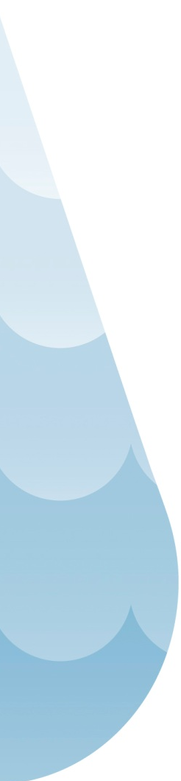

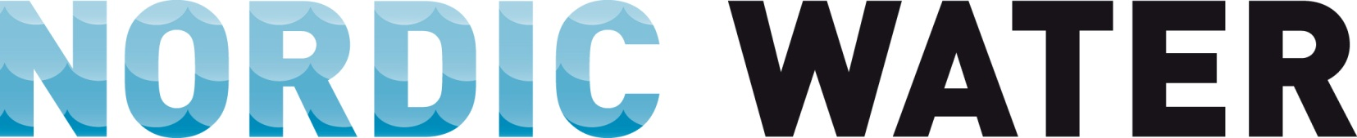
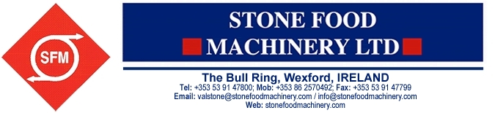
And Local Agents

Slide 2

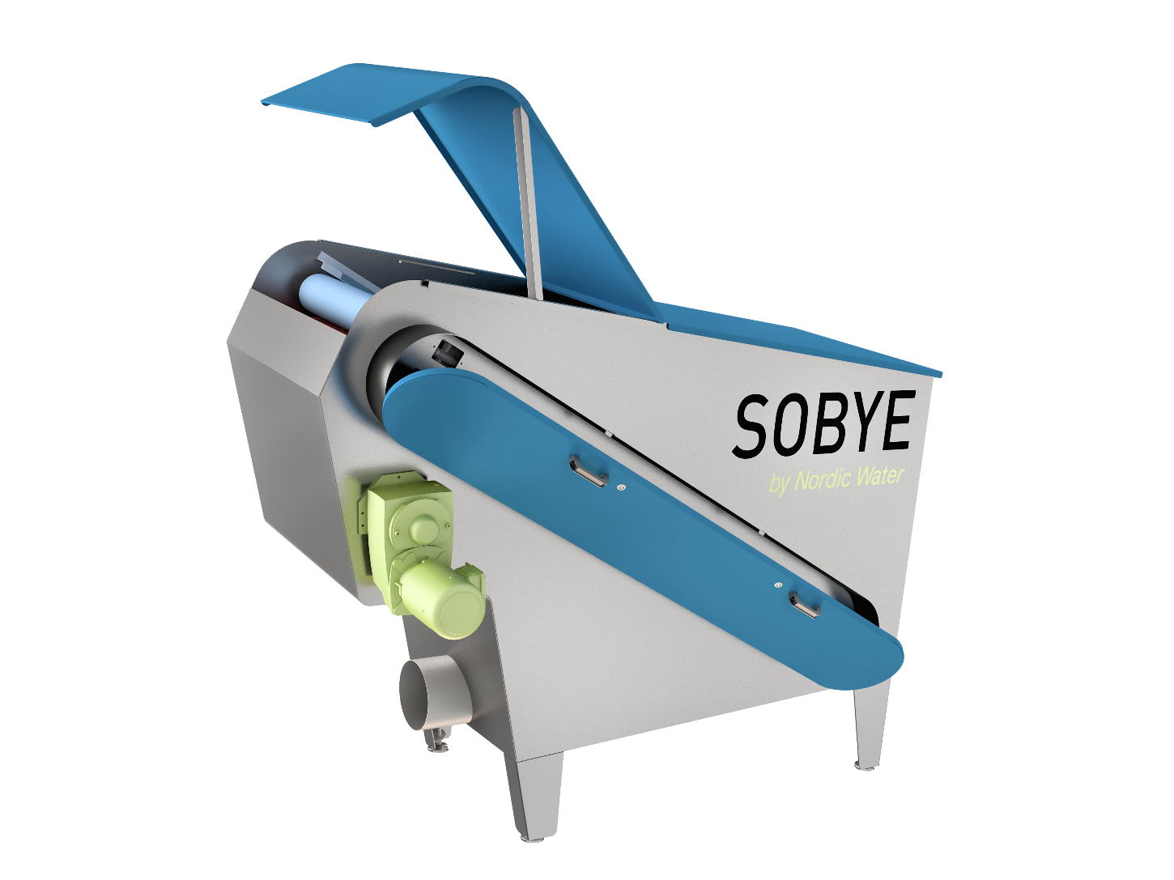






Sobye – Welcome to Nordic Water

Slide 3
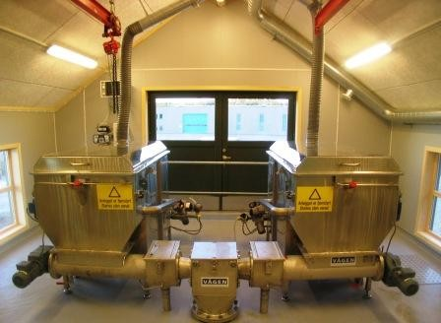
History of Sobye
Founded in 1986, on Sotra Island outside Bergen, Norway
Founder, Leif Atle Håkonsund, still in the company
Product supplier and contractor, based on the Sobye Filter
To date, focused on home market Norway, with approx 200 installations
Aquired by Nordic Water, March 2016, with the intention to bring the product world wide
A redesign of the product was initiated in January, and the result we will see today.
A full program of the new design epected by the end of the year.

Slide 4
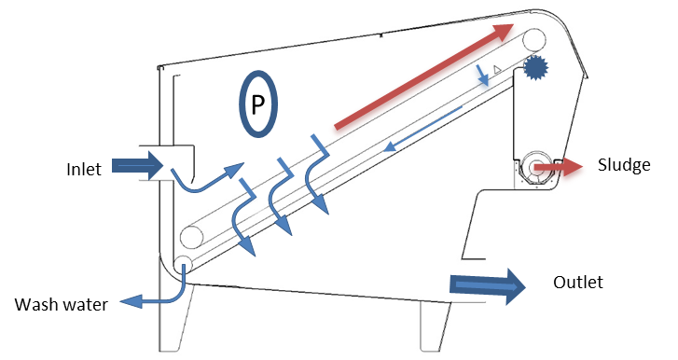
Operation principle
Waste water is pumped to the inlet above the belt.
Water is filtered trough the screen belt and the water level rises.
A pressure sensor (P) starts and stops the belt.
The belt motor is frequency controlled, to build up
a layer on the cloth for increased filtration.
Filtered water is discharged from the tank bottom.
Particles are removed from the screen belt a rotating
brush and the screen belt is cleaned by a spray bar.
The dry particle sludge fall into a screw
conveyer for further wash and press.
The wash water outlet can be returned to pump
sump together with reject water from the press.
An internal emergency overflow wier is located
above the inlet compartment.

Slide 5
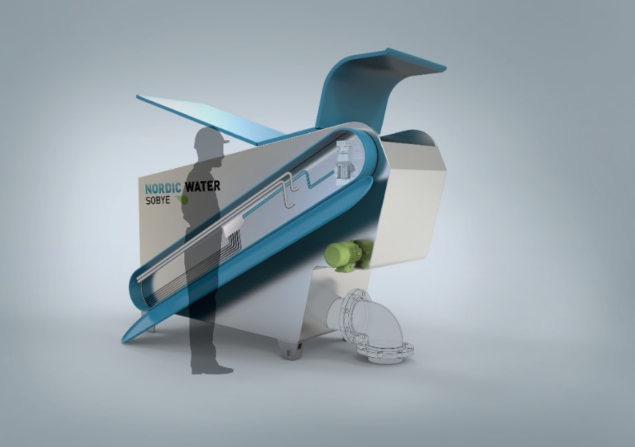
Sizes and models
Three sizes are suitable for municipal waste water
Freestanding units in Stainless Steel EN1.4404
(Channel filter units will follow later)
Model: | Belt type: | Effective filter area
Sobye TD 07 | 400-4970 | 0,74 m2
Sobye TD 14 | 740-4970 | 1,45m2
Sobye TD 20 | 1040-4970 | 2,0 m2
Polyester belts cloth from 60 -1000 micron
(Standard 120, 300, 500, 800 ym)
(other range of filters will follow later)
Control cabinet and belt drive motor in IP-67, 0,37kW
Motor for brush in IP-56, 0,12 kW

Slide 6

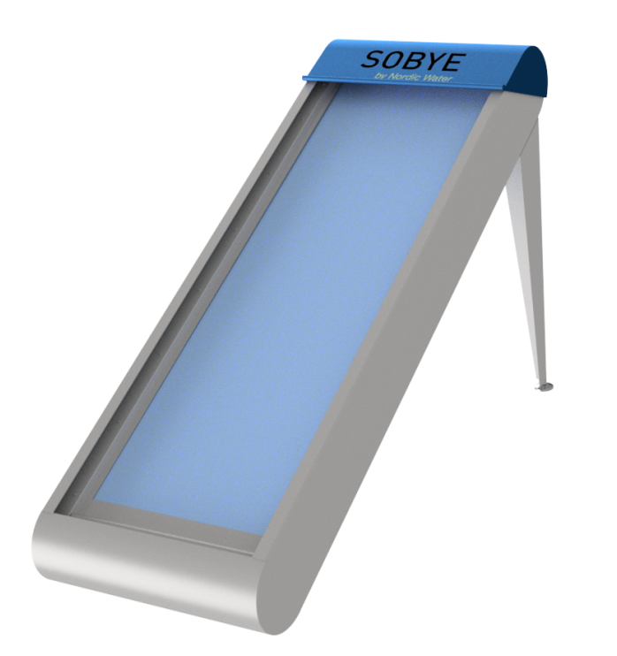
Sizes and models
Tank Design Models TD
Channel Design Models CD

Slide 7
Operation
Operates on the principle of
building a mat of screenings
to improve separation
Filtration time more important
than opening

Slide 8
Operation
Removal rate, TSS at different filtration time and openings.

Slide 9
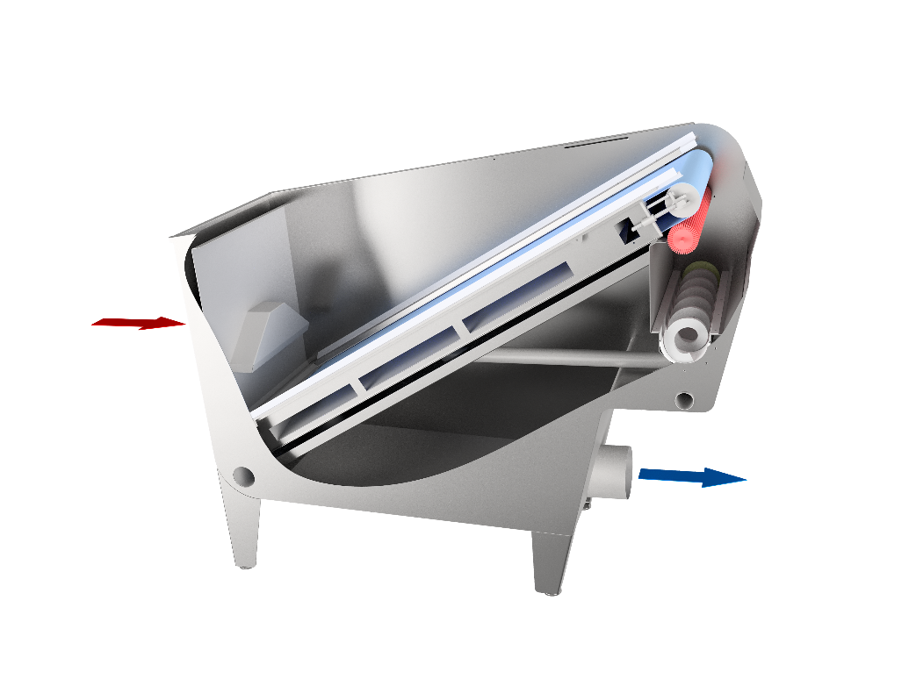
Technical information
Filter belt cassette is easy removable, and the belt could be changed within an hour
Hot and cold city water or technical water is added directly into unit, min 6 bars. If not enough pressure a small pump could be arranged

Slide 10
Applications
Applications with references
Industrial applications (Fish & Aquaculture)
Primary treatment plant “Ocean outfall”, or storm water treatment
Chemically assisted treatment, Industrial and Municipal
Fine Screening
New Applications:
Combination with DynaDisc, DynaSand Oxy/Deni etc
Industrial applications i.e Paper industry, Wineries, Food processing
Pre- treatment before membrane
……….
Example: -Primary waste water filtration:
Normally 50% SS reduction and 20% BOD reduction on primary waste water filtration
(Without chemical additions)
-Surface loading rate 50-70 m/h and about 125 my cloth (most common is 350 my)
About 25-35% dry matter content in sludge

Slide 11
Application areas today
Screenings -> Incineration
Less residual particles (SSout)
Sludge -> Digestion -> Bio gas
Polishing / Tertiary Treatment
DynaSand
DynaDisc
Lamella
/
Zickert
Sedimentation
Sobye
Screens & Screenings
MEVA
Dry Solids content (DSout)

Slide 12
Application areas of tomorrow
Screenings -> Incineration
Less residual particles (SSout)
Sludge -> Digestion -> Bio gas
Polishing / Tertiary treatment
DynaSand
DynaDisc
Lamella
/
Zickert
Sedimentation
Sobye
Screens & Screenings
MEVA
Dry Solids content (DSout)

Slide 13
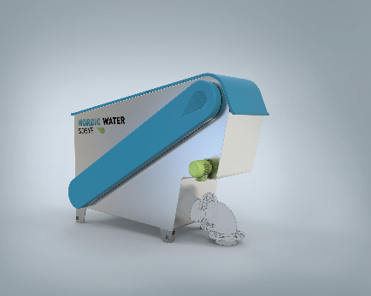
Primary treatment plant
(Ocean outfall)
The filter belt is cleaned with brush and integrated spray wash @ 6 bar.
- Hot water periodically typically once a week -To remove fat & grease .
Reject water and wash water is lead back to pump sump.

Slide 14
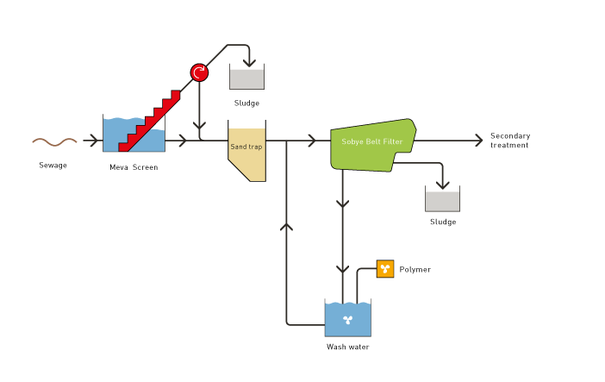
Primary filtration
-separation of screenings & sludge w/o chemicals
Dry Sludge 20-25% DS
Options can give less
or more dewatering

Slide 15
Extended Primary filtration
-separation of screenings & sludge

Slide 16
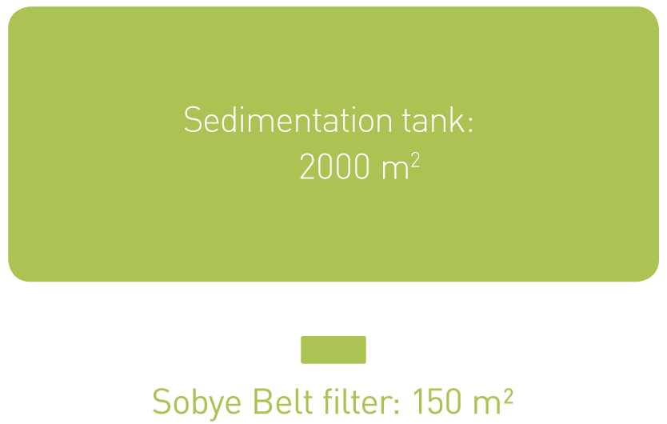
Sobye Primary filtration
Primary filtration vs Primary sedimentation
STRENGTHS
Smaller footprint
Lower investment cost
Much dryer sludge
Low transport cost
OPPORTUNITIES
Similar reduction rates
Similar energy costs
Nordic Water & Representatives know-how

Slide 17
Design
High hydraulic capacity, typically up to 300 m3/h/m2 in wastewater
Design Surface loading rate in primary treatment in order
to meet 50% SS reduction and 20% BOD reduction:
- 20 – 80 m/hour, depending on the characteristics of the waste water.
Integrated press typically gives a DS of 20-25%
Can be delivered without press for use with existing sludge treatment
Can be delivered with separate High effiecency press, 40% DS+

Slide 18
Test equipment

Slide 19
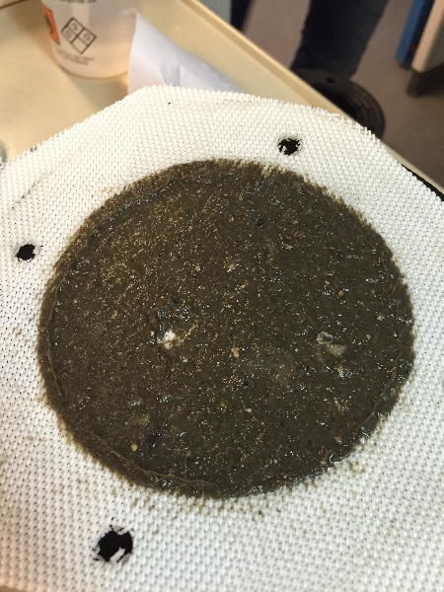
Example – Leaf test
Inlet Municipal waste water, after screen
Seaby WWTP 29/8-2016
Ferric sulfate: 200ml PIX 113/m3
Polymer: 12 ml C2260 0,2%
 | COD mg/l | TN mg/l | TP mg/l | SS mg/l
Average values 24h | 2300 | 124 | 16,5 | 860
Fe + Polymer ( 300ym ) | 542 | 71 | 1,02 | 50

Slide 20
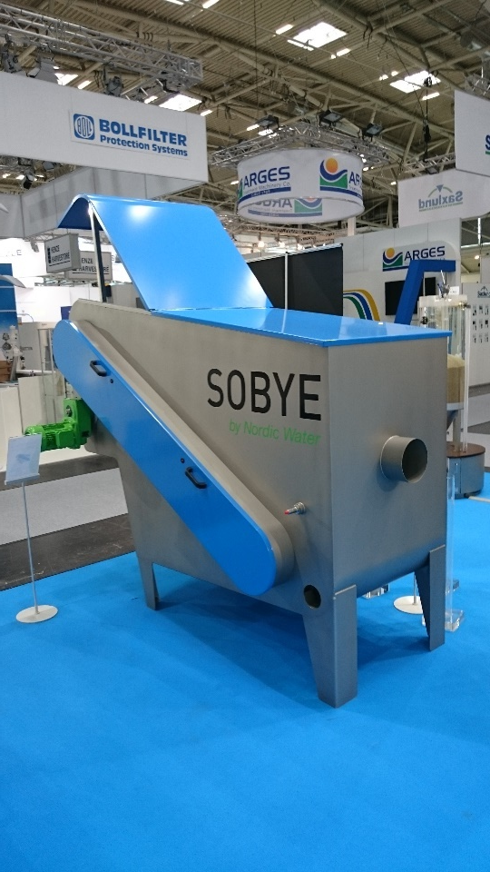
Pilots & exhibition models
  One TD14 exhibition model is available to rent
  for exhibition display.
  Two new pilots of the original Sobye 0,4m2 are
  available to rent.

Slide 21
Please contact:
Val W Stone or Alison Stone- Thompson :

